Slide 1
PROJECT ON
Medicine Name Detector
Submitted By: Guided By:
Vikas Singh(1416510144) Mr. Rahul Singh
Praveen Kumar (1416510085) (Assistant Professor)
Mohd. Abujar(1416510062)

Slide 2
Contents
Introduction
Driving Principle For The Design
Overview Of Existing Apps
Optical Character Recognition On Android
Text To Speech On Android
Block Diagram
Users
App Graphical User Interface
Conclusion

Slide 3
Introduction
The wide-ranging eye problems make simple daily tasks difficult, or even impossible, for older people.
According to a recent survey by a national organisation for ophthalmologists India accounts for 20% of the total blind population of the world, with 7.8 million visually impaired out of the 39 million across the globe. India is now home to the world's largest number of blind people .
This app helps the blind and visually impaired person to listen the name of medicine printed on cover so that person will not take wrong medicine.

Slide 4
Driving Principle For The Design
The main reasons for choosing this project are:
a. Making a disable an independent.
b. Choose right medicine before take.
Our project aims at removing such constraints by helping the visually challenged person to know what medicine is it and why it is used independently without restricting his/her movements.

Slide 5
Overview Of Existing Apps
Many reading apps for visually-impaired people are already available and quite popular too.
These apps make use of a phone camera which scans the entire document and subsequently the in-built optical recognition system extracts the text from the page.
But there is no application which scan the medicine cover and speak the right name of medicine and why it is used.

Slide 6
Optical Character Recognition on Android
Text recognition is the process of detecting text in images and video streams and recognizing the text contained therein.
The Text Recognizer segments text into blocks, lines, and words. Roughly speaking:
* A block is a contiguous set of text lines, such as a paragraph or column.
* A line is a contiguous set of words on the same vertical axis, and
* A word is a contiguous set of alphanumeric characters on the same vertical axis.

Slide 7
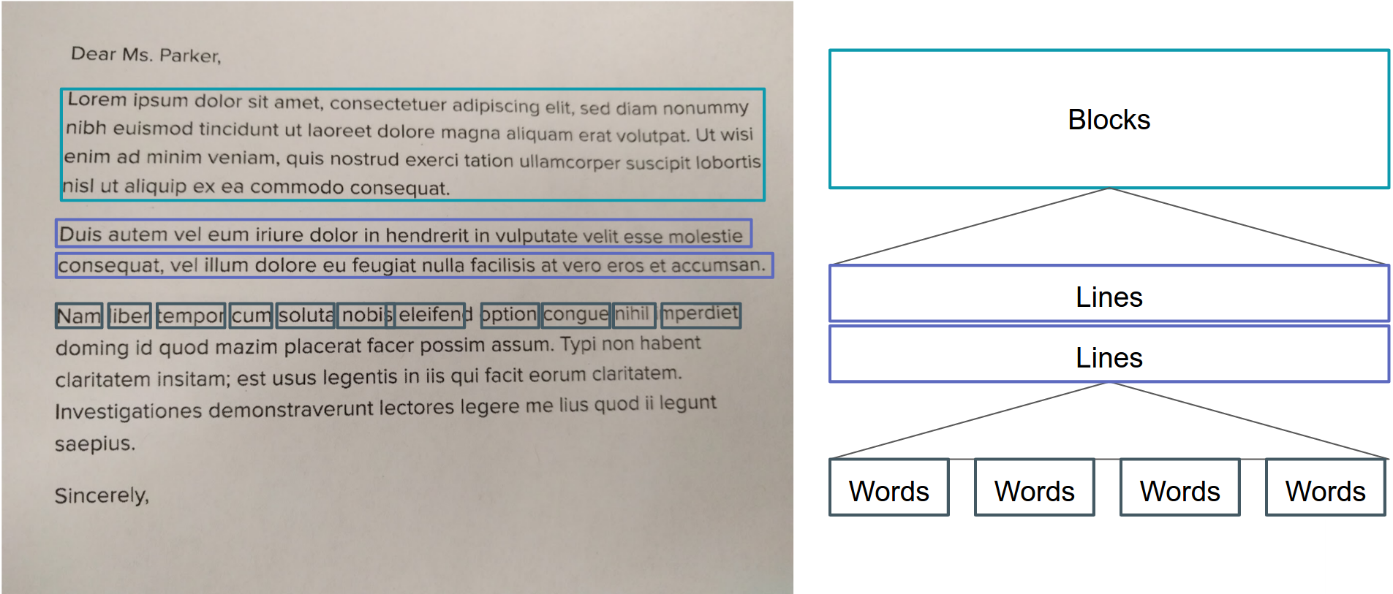
Fig. 1: Text recognition segments

Slide 8
Text To Speech On Android
Text-To-Speech (TTS) also known as “speech synthesis”. TTS enables your Android device to “speak” text of different languages.
It is one of the major applications of Natural Language Processing (NLP).
The NLP module contains various blocks: preprocessor, text analyzer, morphological analyzer, contextual analyzer, syntactic prosodic parser, letter to sound module and prosody generator

Slide 9
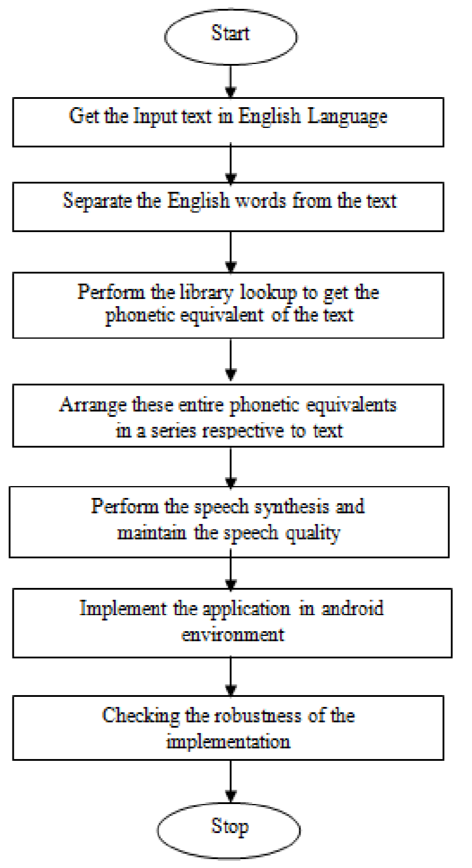
Algorithm For English Text To English Speech Conversion

Slide 10
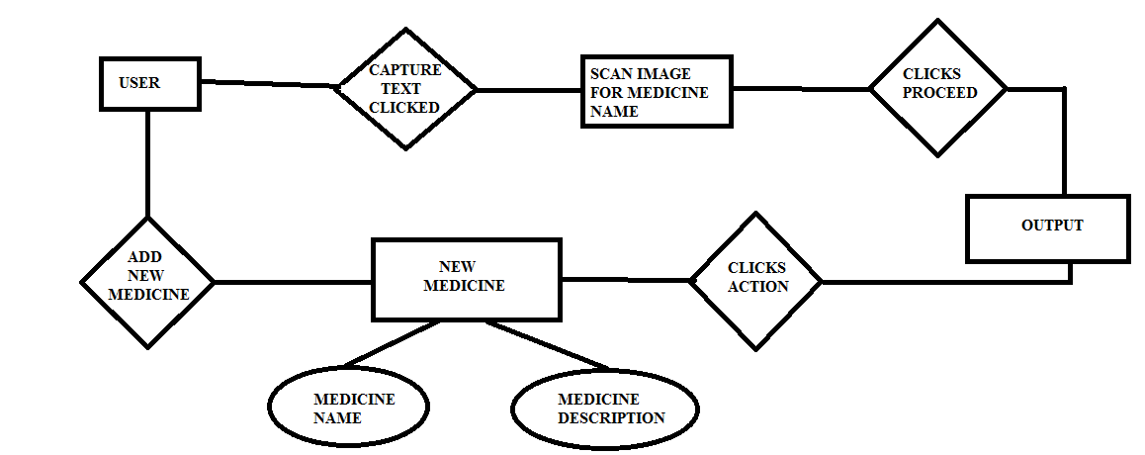
Block Diagram
Fig. 3: Block diagram of medicine name detector

Slide 11
Users
Helper : A person that can help to add some medicine name and description for blind person.
Blind user: A person that use this app for knowing the name of medicine and why it is use.

Slide 12
App Graphical User Interface

Slide 13
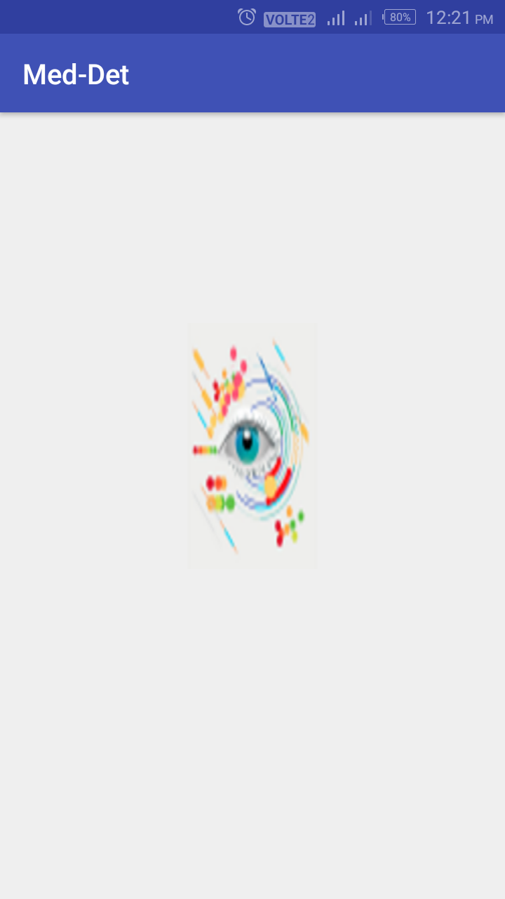
1. Splash Screen

Slide 14
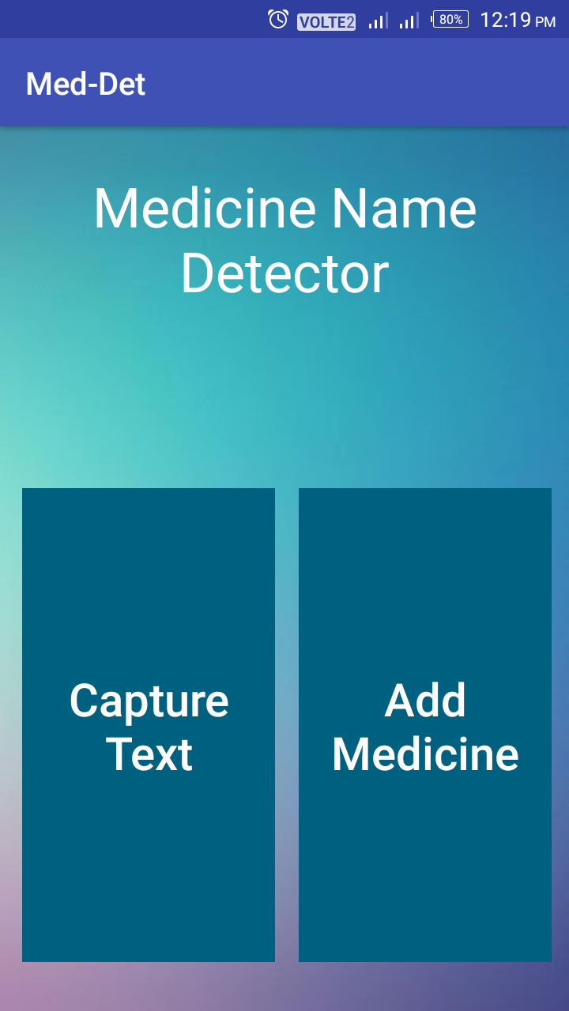
2. Home Screen

Slide 15
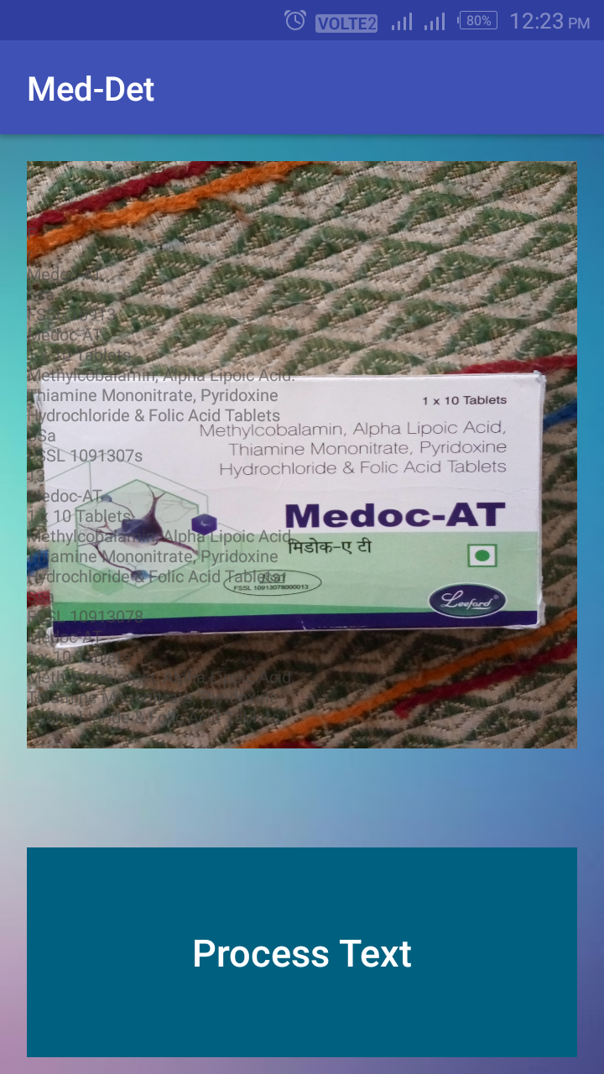
3. When User Clicks Capture Text Button

Slide 16
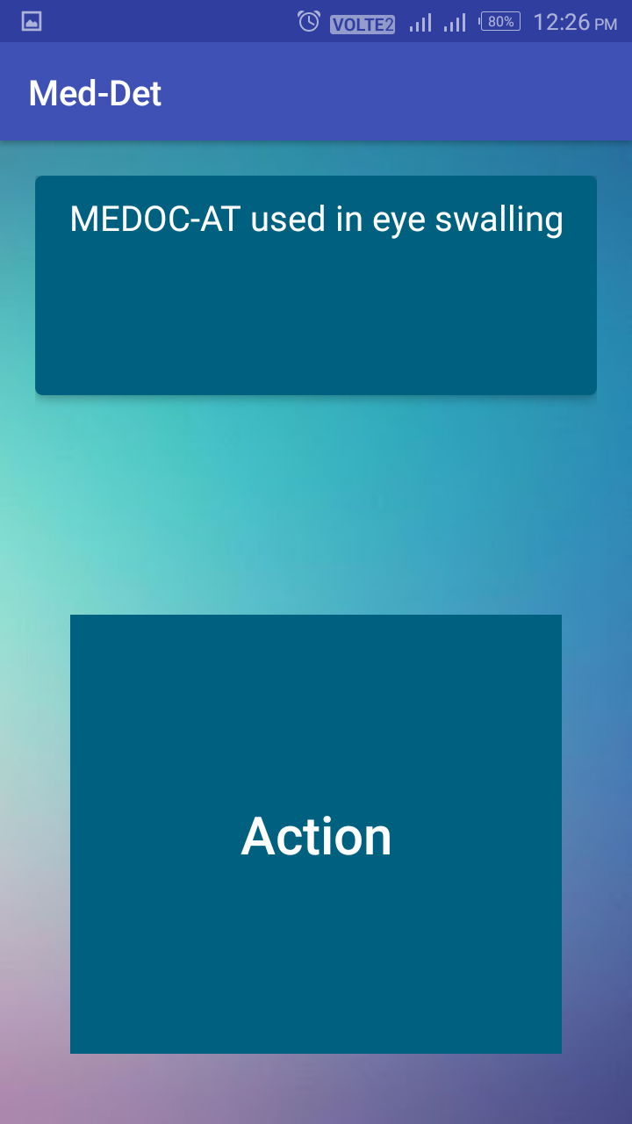
4. After Accurate Detection Of Medicine Name

Slide 17
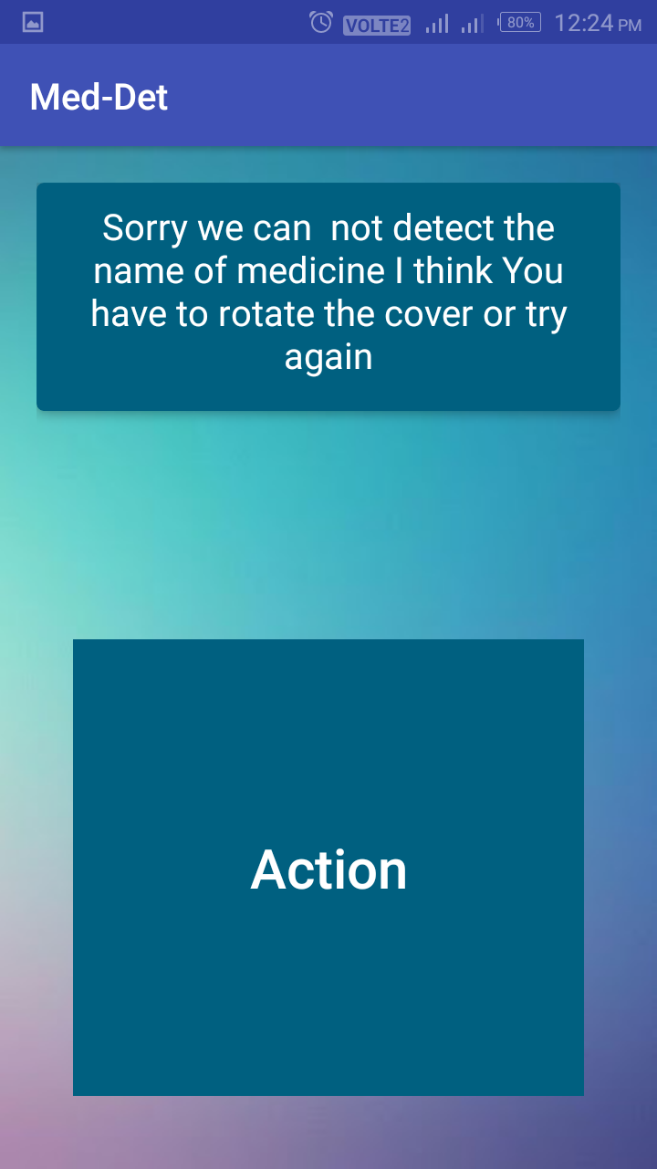
5. When Medicine Name Is Not Detected Properly

Slide 18
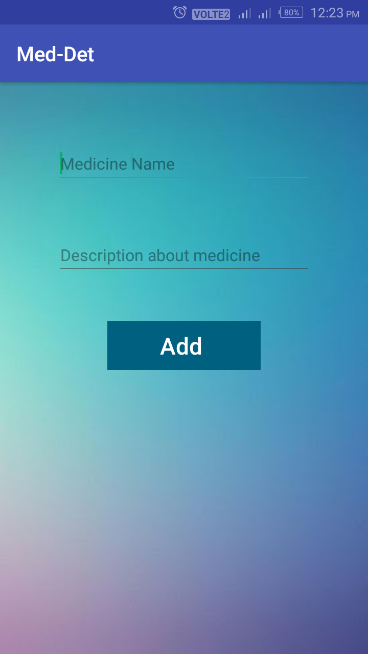
6. When User Clicks Add Medicine Button

Slide 19
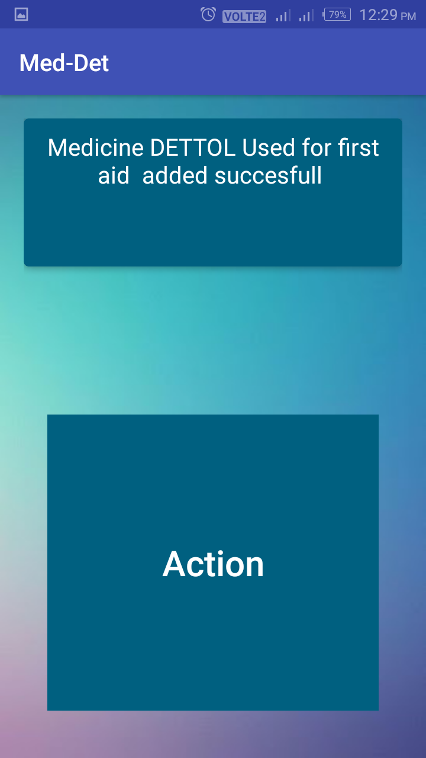
7. When A New Customized Medicine Is Added Successfully

Slide 20
Conclusion
The app “Medicine Name Detector” consisted of the construction of an application composed by several parts, scan the image by mobile device, then used an OCR API for recognition of its text from image, which is then synthesized through a process of TTS.
At last app speak the name of medicine and why it is use.

Slide 21
Thank You

